Slide 1
MSSP 608: Practical Machine Learning Methods Sadiq Y. Patel
1

Slide 2
About me
Postdoctoral Research Fellow (Harvard Medical School)
PhD in Social Policy (UChicago)
MS in Biostatistics (UChicago)
Consultant at Accenture (financial technology and data analytics)
Teach for America
MSW

Slide 3
Course Objectives:
Breaking down real-world problems into machine learning tasks, inputs, and outputs
Using Python libraries to train classification, regression, and clustering models
Optimizing models through model selection, feature design, and hyperparameter tuning.
Evaluating dataset inter-annotator reliability, trained model accuracy, and error
Recognizing the capacity and limitations of models for fairness
Describing results of machine learning experiments with real-world implications

Slide 4
Course Logistics:
Course material
Concepts will be taught in class synchronously (~1.5 hours)
Coding will be taught asynchronously (~45 min – 1 hour)
I will post video and code prior to lecture
Homework
We will create videos for homework assignments to get you started with code
Use TA office hours for additional help
There will be 4 TA sessions per week – you MUST attend at least one

Slide 5
Course Grading:
5 assignments (50%)
11 quizzes (30%)
Final project (20%)
Completed in groups of 4-5

Slide 6
What is predictive analytics?
https://www.youtube.com/watch?v=GO8Cd2eUTVE
https://www.youtube.com/watch?v=uk82DHcU7z8

Slide 7
Real-world ML Process
System Objective: What problem will my system solve? What is the target deployment scenario? What are the performance objectives?
Approach: What is my solution and its components?
Data Collection
Identifying the data sources: What are my data sources ?
Collecting the data
Data Preparation
Preparing the data: Is my data business ready?
Ingesting the data: What is the right storage for my data
Model Development
Data preprocessing
Identification and training
Model evaluation
Hyperparameter Tuning
Model Deployment
Model optimization (if needed) for the deployment infrastructure
Model packaging and deployment
Monitoring and Feedback
Is my deployed model performing as expected?
Is there a drift in model performance which requires re-training?

Slide 8
is it really THAT simple?
Example of an ML Pipeline
YES IT IS!!!

Slide 9
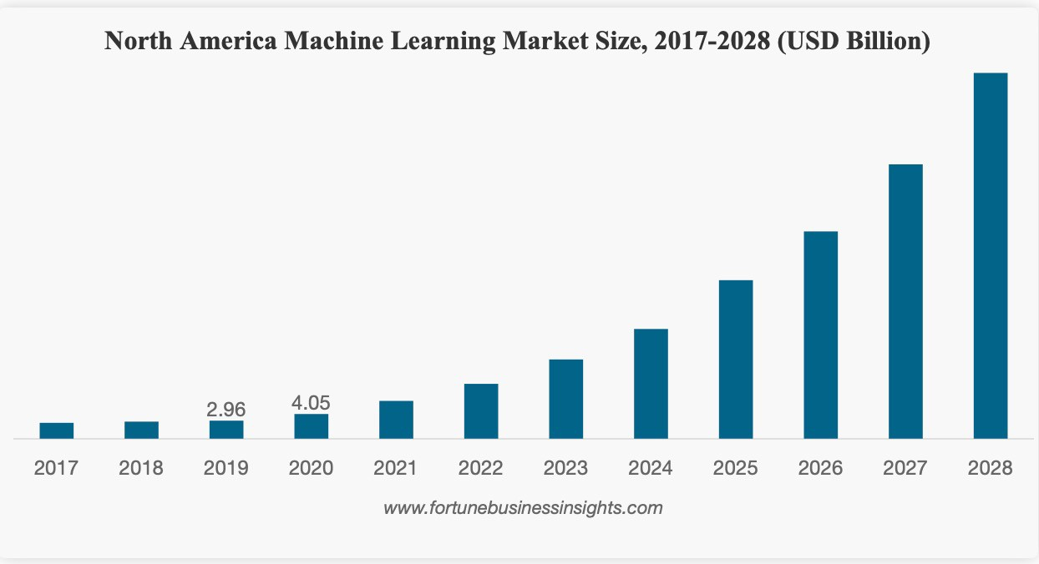
Machine Learning Popularity

Slide 10
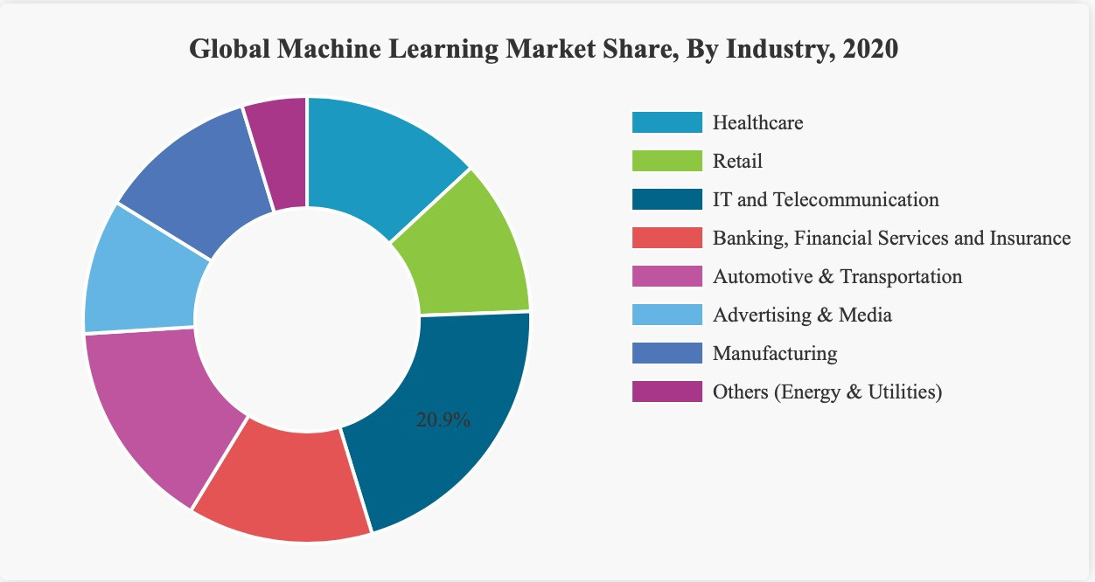
Machine Learning Market Share, By Industry

Slide 11
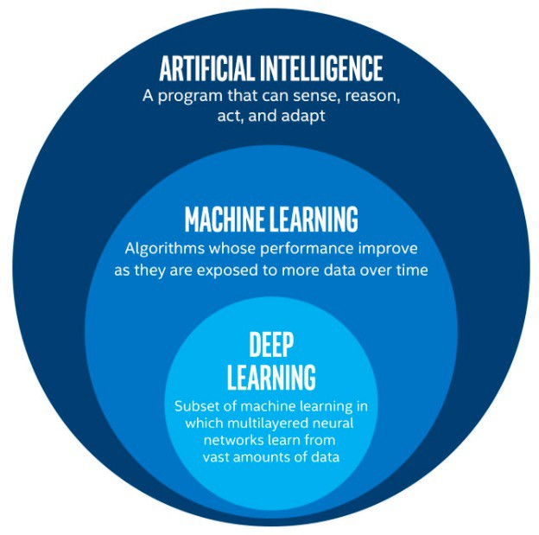
AI vs. ML vs. DL?
https://www.youtube.com/watch?v=w-8MTXT_N6A
11

Slide 12
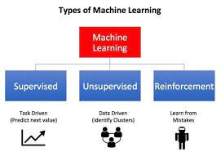
Types of Machine Learning

Slide 13
What is Machine Learning?
Set of algorithms who learn from data and help make sense of data
Performance improves with more data
"Practical" Machine Learning
https://www.youtube.com/watch?v=ukzFI9rgwfU

Slide 14
Key Areas
Supervised Learning
Feature vs. Label relationship?
Learning with labeled data
Unsupervised Learning
No labels
Learning with unlabeled data
Reinforcement Learning
Positive vs. negative feedback
https://www.youtube.com/watch?v=yN7ypxC7838

Slide 15
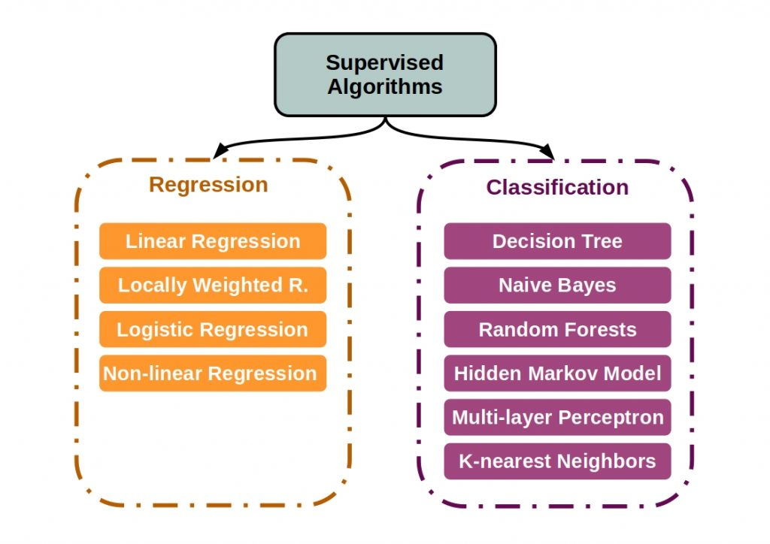
Supervised Learning

Slide 16
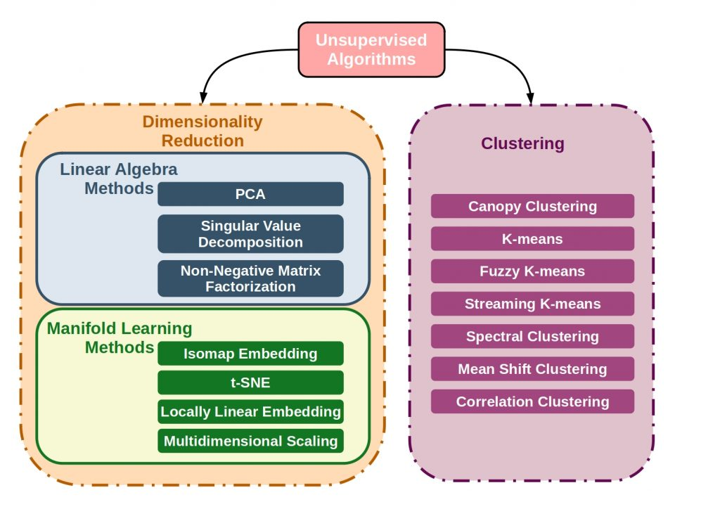
Unsupervised Learning

Slide 17
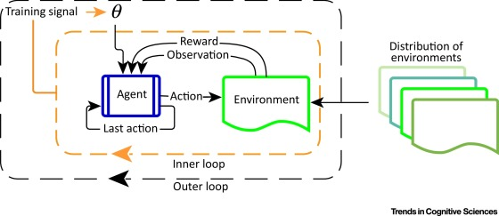
Reinforcement Learning

Slide 18
Algorithms Bias and Fairness
Data reflects existing biases
Unbalanced classes in training data
Data does not capture the right value
Data amplified by a feedback loop
Malicious data attack or manipulation
https://www.youtube.com/watch?v=gV0_raKR2UQ

Slide 19
ML Model Training and Inference
Training
Evaluation
Hyperparameter tuning
Prediction/Inference
https://www.youtube.com/watch?v=nKW8Ndu7Mjw
https://towardsdatascience.com/the-7-steps-of-machine-learning-2877d7e5548e

Slide 20
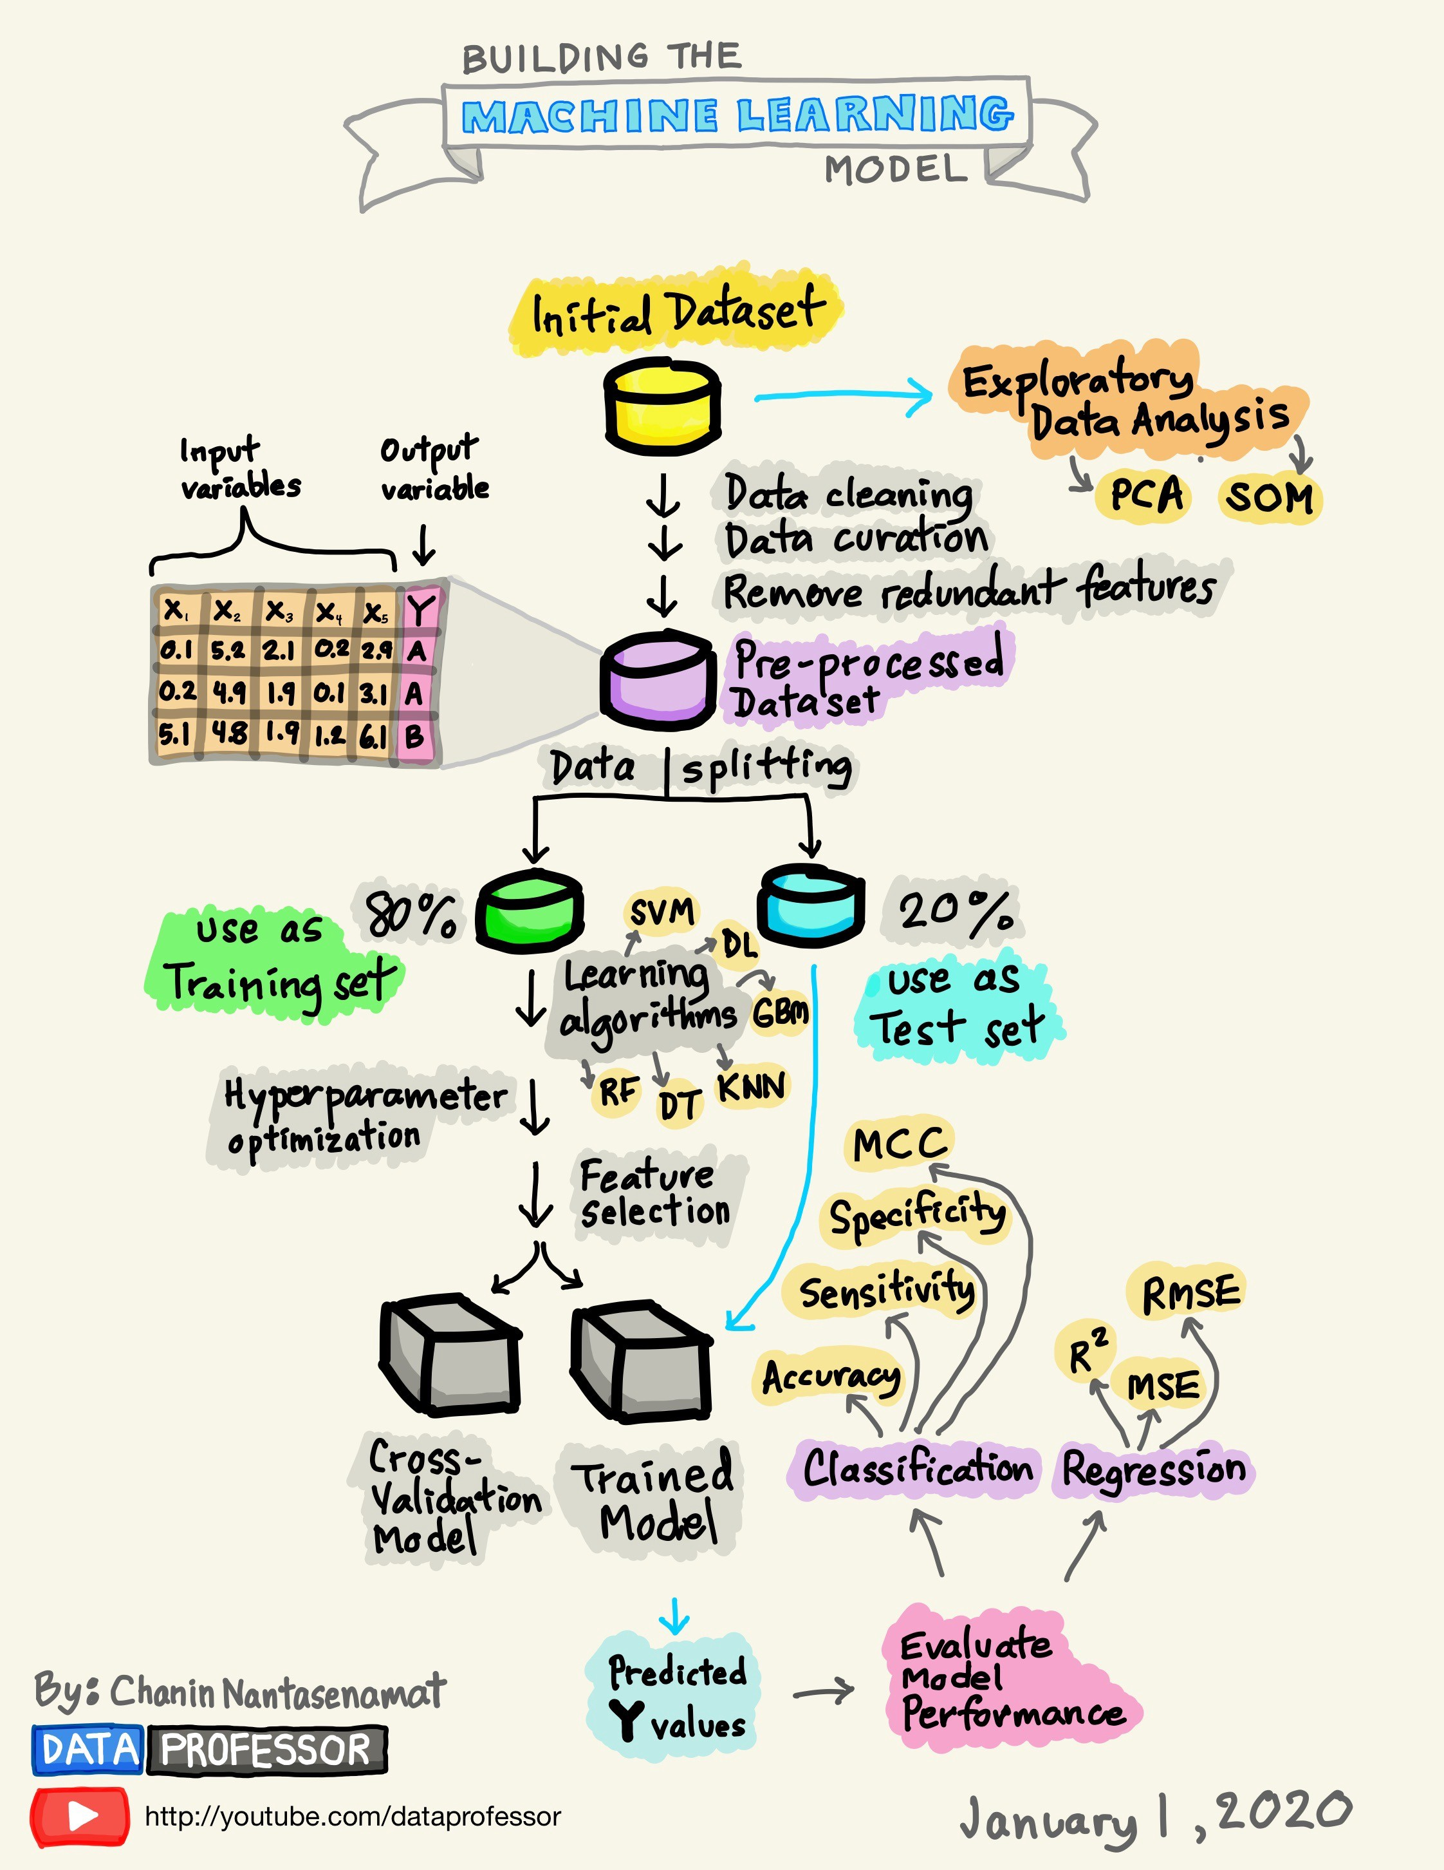
https://towardsdatascience.com/how-to-build-a-machine-learning-model-439ab8fb3fb1

